Slide 2
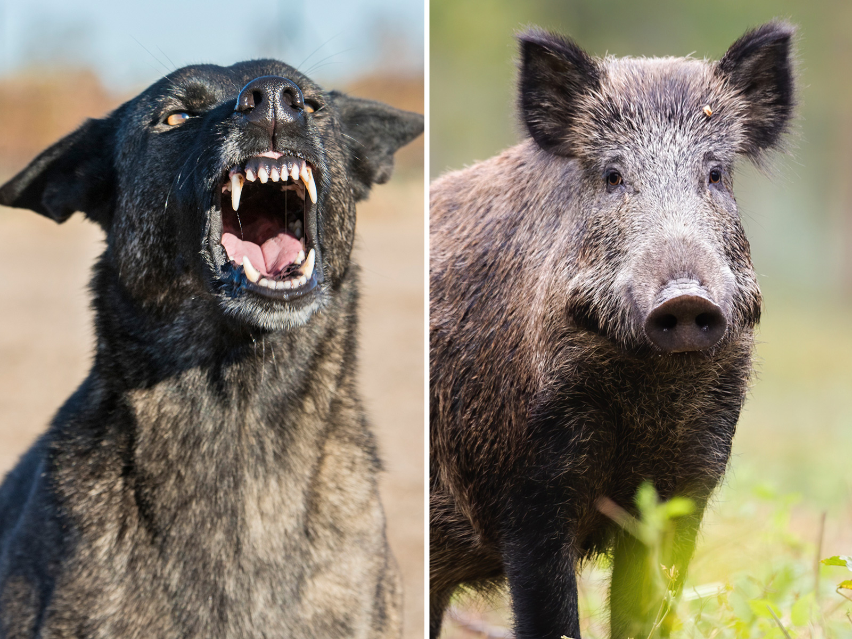
Sermon on the Mount
Matthew 5-7
“Dogs & Pigs”
Matthew 7:6

Slide 3
Sermon
on
the Mount
HISTORY OF DOGS & PIGS
Leviticus 11:4,7,8 – “unclean to you”
Matthew 8:30-32 – “whole herd of swine… perished in the water.”
Luke 15:15,16 – “feed swine…”
2 Peter 2:22 – “sow having washed… wallowing in the mire.”

Slide 4
Sermon
on
the Mount
HISTORY OF DOGS & PIGS
What Do The Two Prohibitions Represent?
“DOG” – a popular insult; metaphor for Gentiles
“PIG” – a metaphor for Gentiles or for Rome
“PEARLS” – rejection of the deliverer or the gospel message: not proclaim gospel to just anybody

Slide 5
Sermon
on
the Mount
WE HAVE AS HOLY WORK TO DO
To Preach The Gospel – Matthew 28:18-20
To Be Firm Against Sin – Ephesians 6:17
Hebrews 4:12; 1 Timothy 6:3-5
To Rebuke Evil – Hebrews 3:8; Titus 2:15
Ephesians 5:11
A Caution – Matthew 7:1-5

Slide 6
Sermon
on
the Mount
OUR WORK IS SPIRITUAL
1 John 1:1-5 – Centered on God
We Have A Holy Book – BIBLE – A Pearl
Because Of The Message It Contains
John 6:63; 1 Corinthians 2:12,13
The Word To Be Revered & Held Sacred
1 Corinthians 1:18; 2 Timothy 3:8

Slide 7
Sermon
on
the Mount
THUS WE NEED HOLY DISCRETION
Dogs And Pigs Must Be Identified And Avoided
Their Works reveal who they are- Matthew 7:20
Those diligently set against the truth
Why Should We Avoid Them?
Waste of effort! Matthew 10:14; Mark 6:11; Luke 9:5
Matthew 13:45,46 “pearl of great price…”
Exodus 5:2 “Who is the Lord,…”

Slide 8
Sermon
on
the Mount
WE CAN AND SHOULD TURN AWAY FROM THOSE WHO ARE OBSTINATE
They HATE the Truth – 2 Thessalonians 2:10-12
The Key To This Lesson Is:
Christians are to go forth militantly with the gospel of Christ, and yet, we cannot impose
The gospel is persuasive – not coercive
When hearers are obstinate and highly motivated against the truth, judgment demands that we retreat to a less hostile, more receptive setting

